Slide 1
How to analyze spines?

Slide 2
Semi-Manual
Spine Type classification and functional Synapse analysis

Slide 3

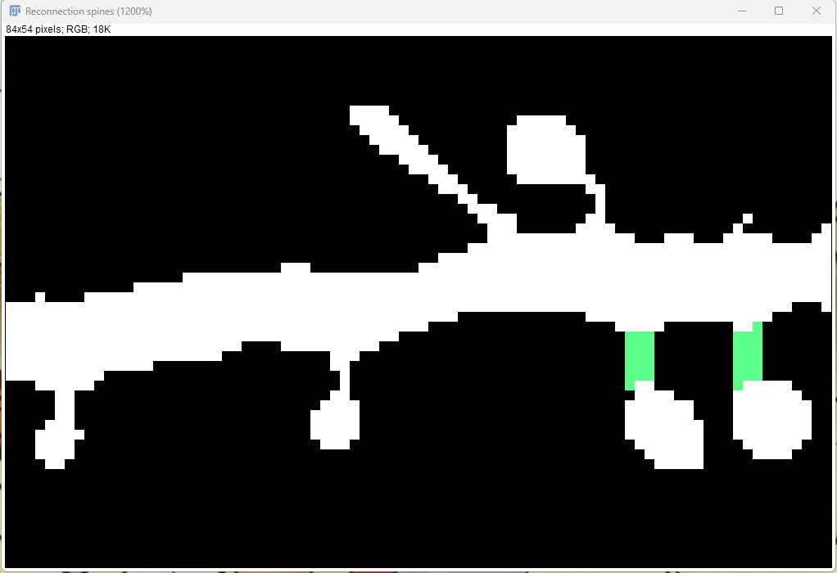
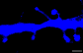
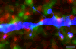
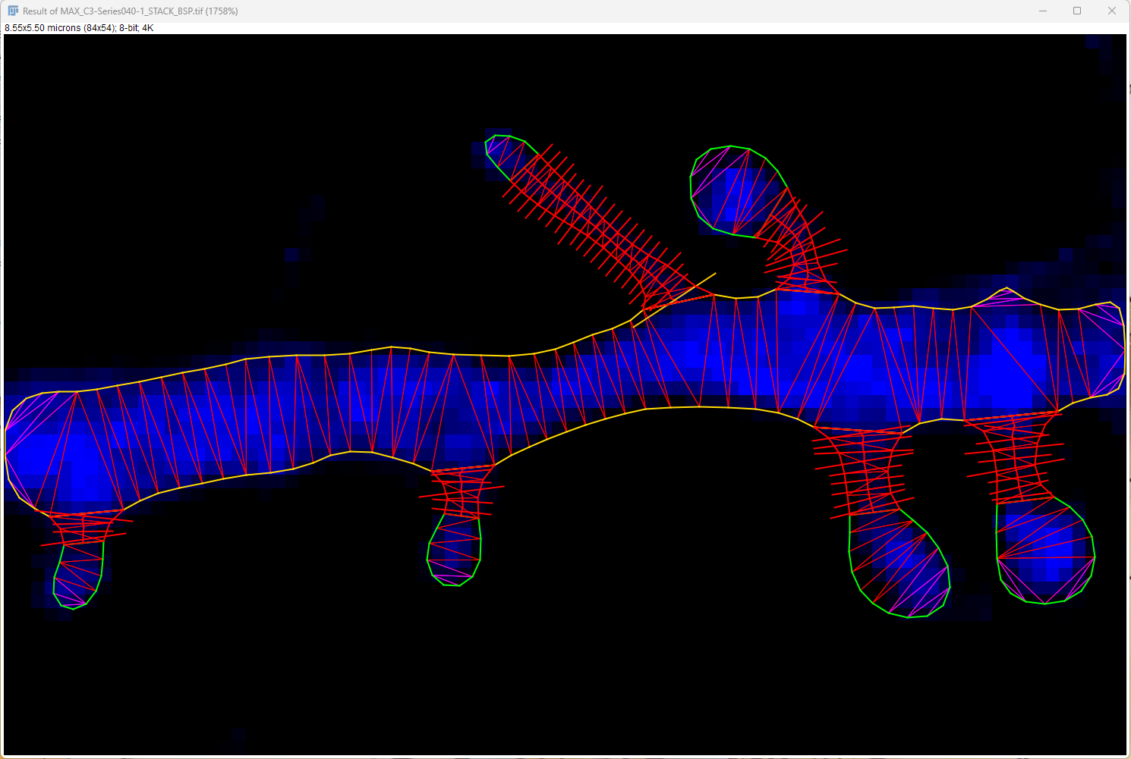
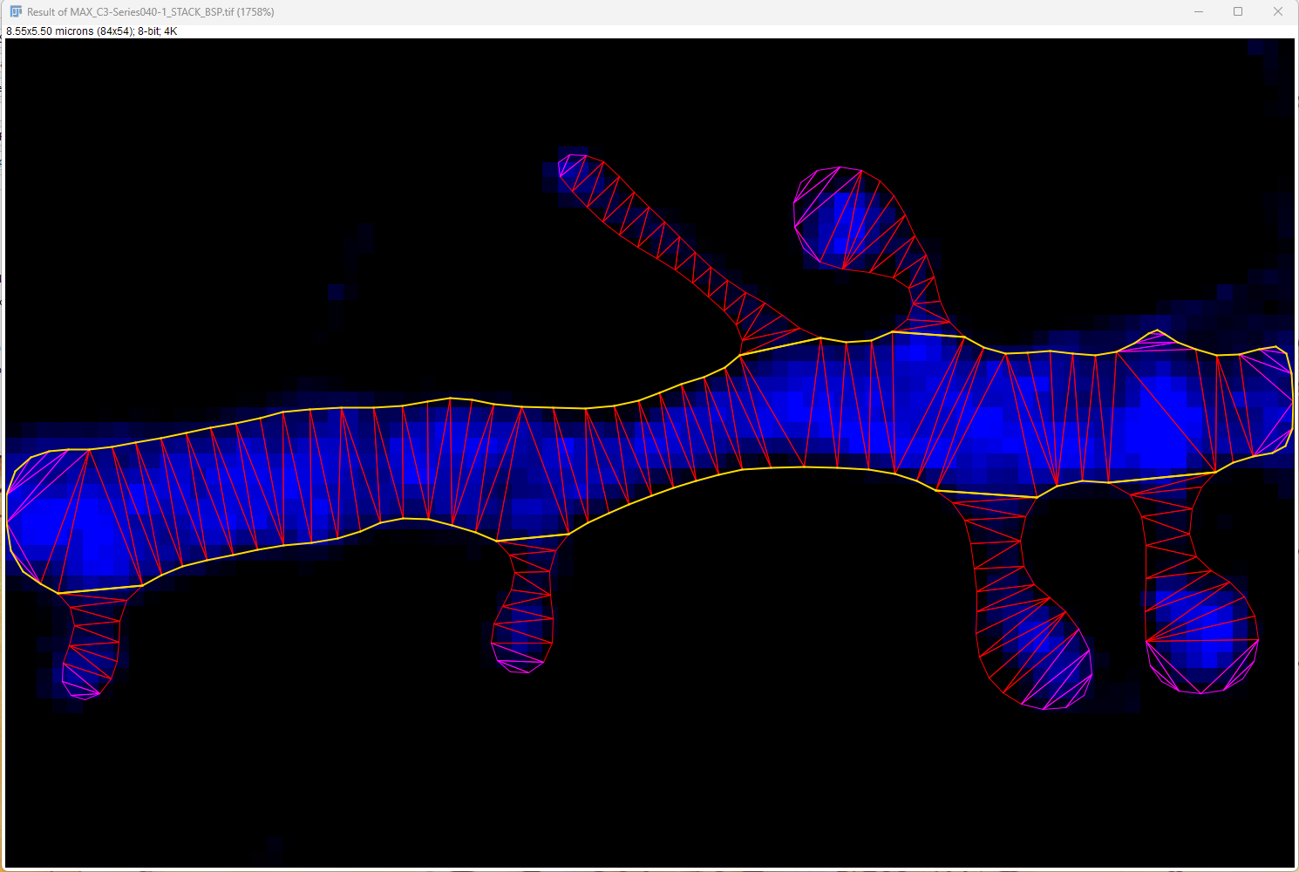
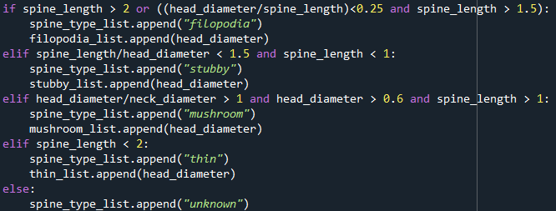
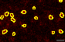
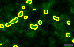
Preview: Spine type and functional synapse analysis
SpineJ: Levet et al., 2020
citrine
PSD-95
SYN
mushroom
filopodia
thin
mushroom
stubby

Slide 4
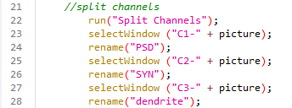
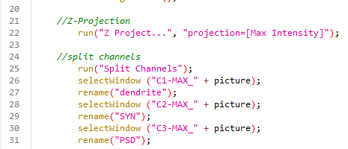
Preprocessing for SpineJ (Levet et al., 2020)
Open the preprocessing_SpineJ.ijm macro in Fiji
Ensure that your channels are set correclty (if not change accordingly)
Press on run and do as indicated by the code (first open the directory of your raw images, then open the folder where you would like to save your data)
The code does the following:
Preprocessing the dendrite for SpineJ analysis:
Applies a Gaussian Blur filter and subtracts it from the orginal one (reduced background noise)
Analyses your synaptophysin and PSD-95 staining:
Applies a Gaussian Blur and unsharped mask filter, then substracts the Gaussian Blur one from the unharped masked one (reduces the background noise and enhances your staining intensity)
Applies Otsu dark threshold to obtain a binarized image (if the thresholding is not good, you can change the thresholding algorithm)
Applies and afterwards analyze particles (size 0.05 µm – infinity) to obtain ROIs of your staining for later analysis
Info: If you have a stack image, enter this:

Slide 5
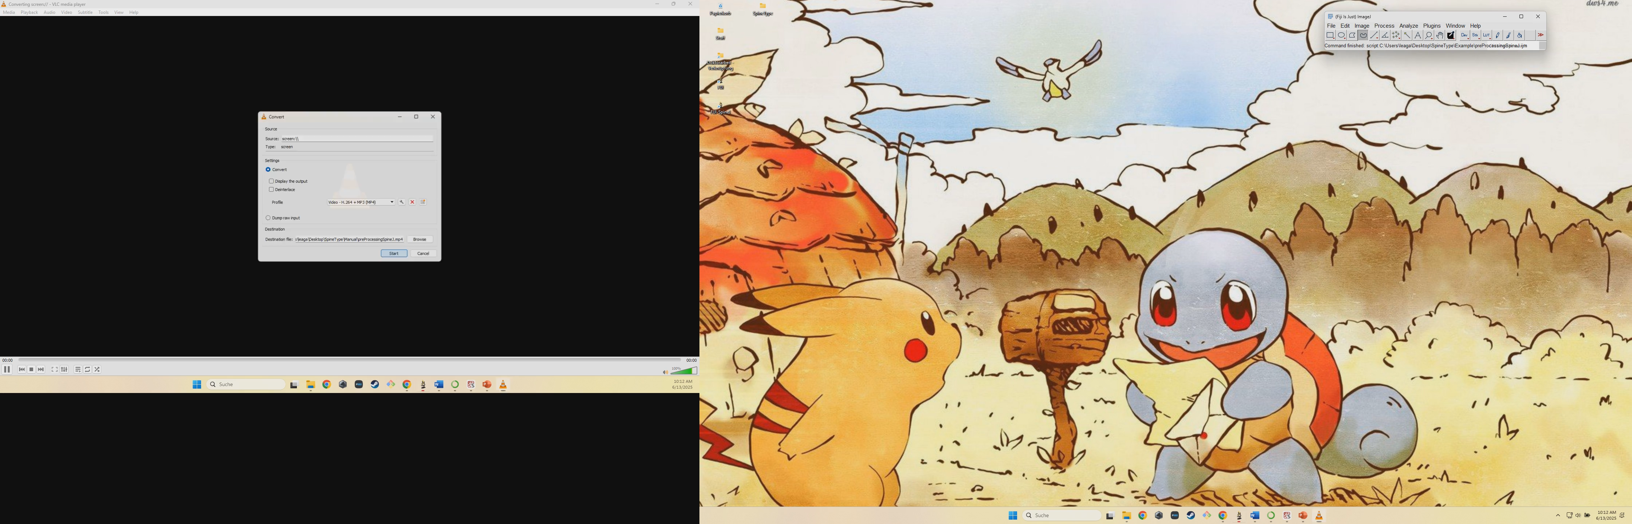

Slide 6
SpineJ Analysis (Levet et al., 2020)
https://pubmed.ncbi.nlm.nih.gov/32006677/
Open the created XX_spine.tif image in Fiji
Cut out the wanted dendrite and delete the rest of the image (is faster as SpineJ does not have to compute the whole image)
Run the SpineJ PlugIN
Select Coefficent 3
Press on Generate Segmentation
The image will be binarized, now be aware of the following:
Make sure to reconnet disconnected spines to the dendrite with the reconnection tool (or via the brush tool)
Dissconnect attached spines, in some cases you have to choose between two spines as they are overlapping
When using the brush tool, make sure to use the pipette tool to change between black and white (if the colors are slightly off, the application will crash)
Select Define neck end in the Interaction Dialog and select for every spine the neck end, be sure to check if the program correctly detected a spine or if there is no spine (if its no spine, you can ignore it, it will not be recognized as long as no neck end is defined)

Slide 7
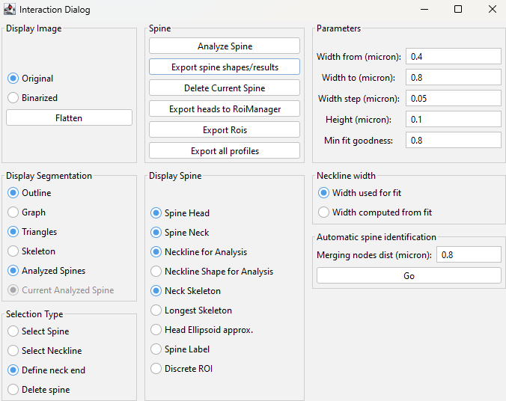
SpineJ Analysis (Levet et al., 2020)
https://pubmed.ncbi.nlm.nih.gov/32006677/
The image will be binarized, now be aware of the following:
If you get an error message, make sure to delete the spine with Delete spine, otherwise your data will be incomplete later on!!!
When you are done with selecting all neck ends, press on Export Rois and Export spine shapes/results
those data are saved at the location of your source image and are neccessary for the analysis as they hold the information about the spine morphology

Slide 8
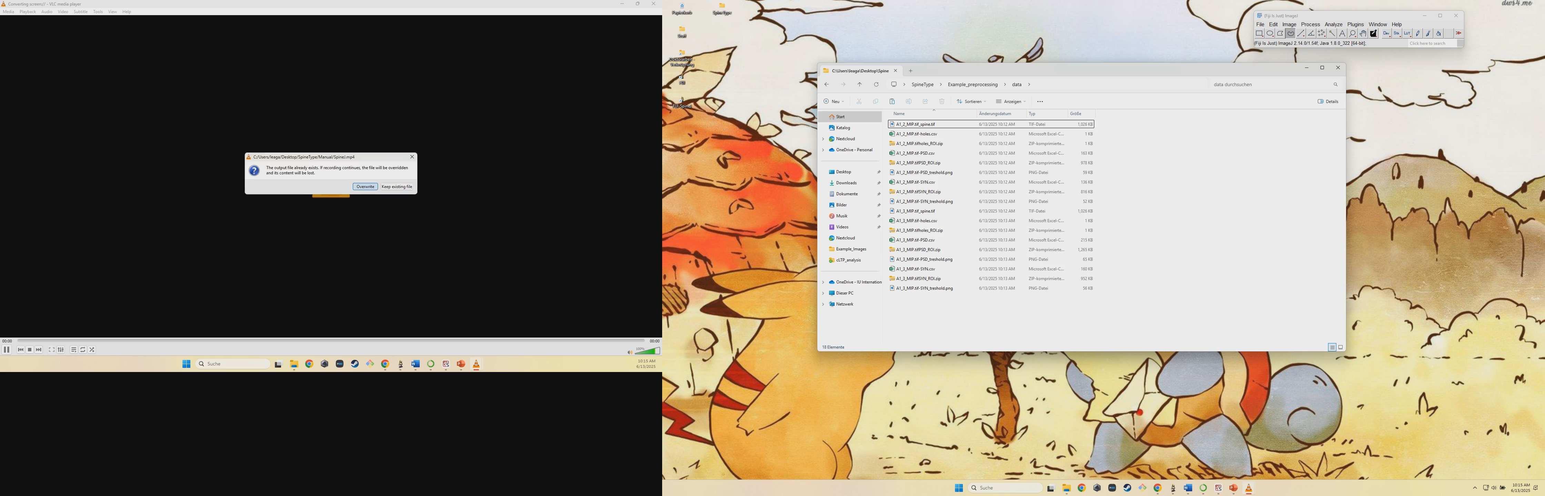

Slide 9
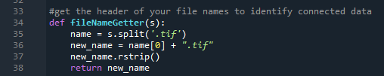
Postprocessing and final data obtainment
To quantify your obtained data, use the code MeanSpineType_and_Synapse_Analysis_SYN_PSD_Transfected_v002.py
Please make sure to change the fileNameGetter if needed (otherwise your data will not be recognized an you get an error message).
Your folder structure is important, so that all your data will be recognized correctly and your conditions will be correct. If you coded your data, you can name your folders according to your condition to decode the data.
FolderWithAllData
ConditionA
Round_A
Round_B
….
ConditionB
Round_A
…
For example: If you have .czi file instead of .tif, change it here!
Results folder:
Errors_in_Cells (if errors occur in files, you can see it here… may have to redo the image)
Filopodia_ConditionA.csv
Mushroom_ConditionA.csv
Stubby_ConditionA.csv
Thin_ConditionA.csv
….

